Slide 1

Journey to your best
Challenge 0 "What's your current version?"
Presentation by Nhat Xuan

Slide 2
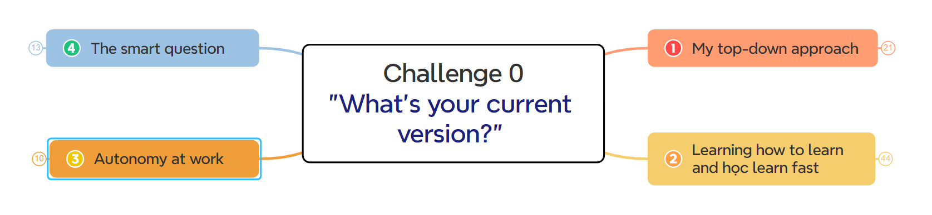
Challenge 0 "What's your current version?"
Mind map | 'What's your current version'

Slide 3
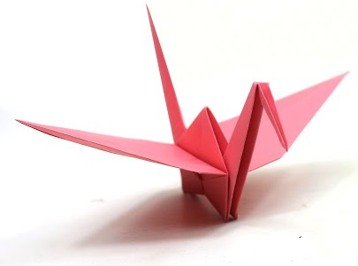
Top-down approach
“is essentially the breaking down of a system to gain insight into its compositional subsystems”

Slide 4
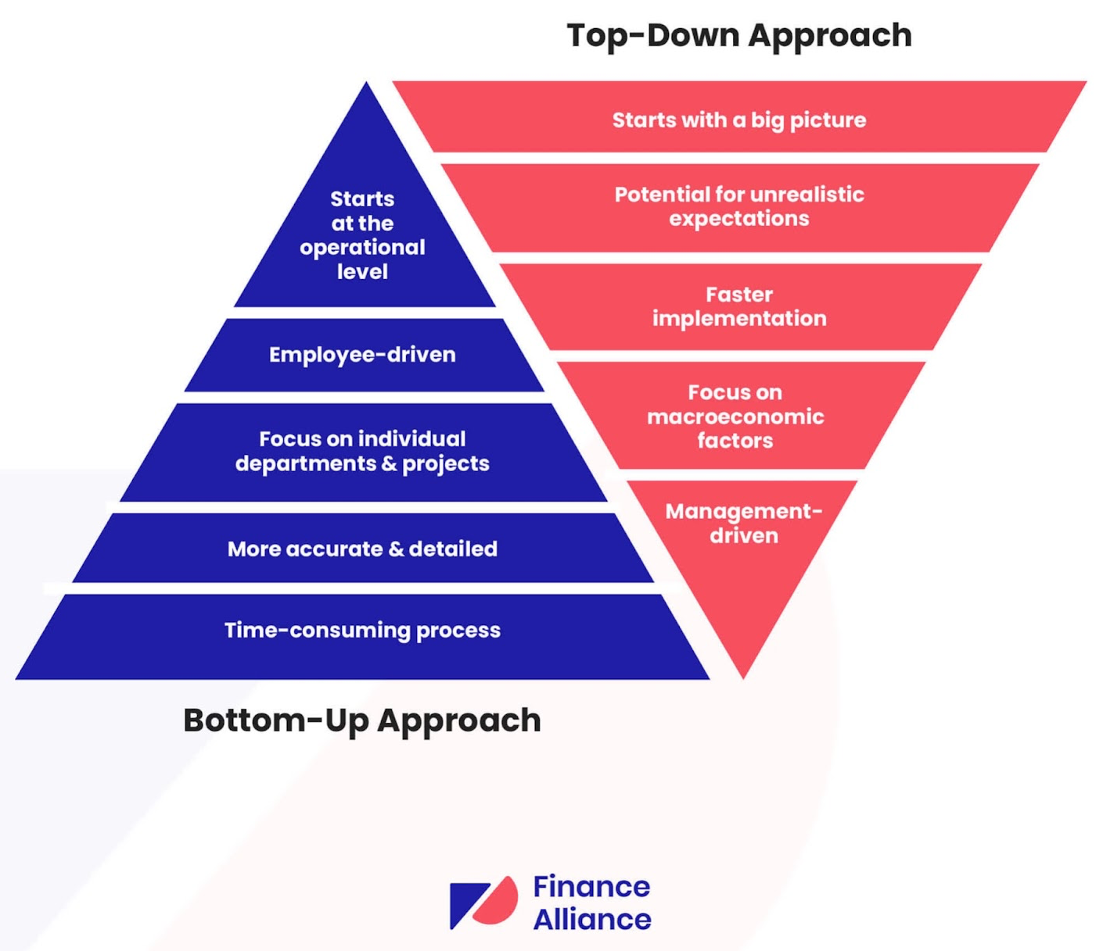
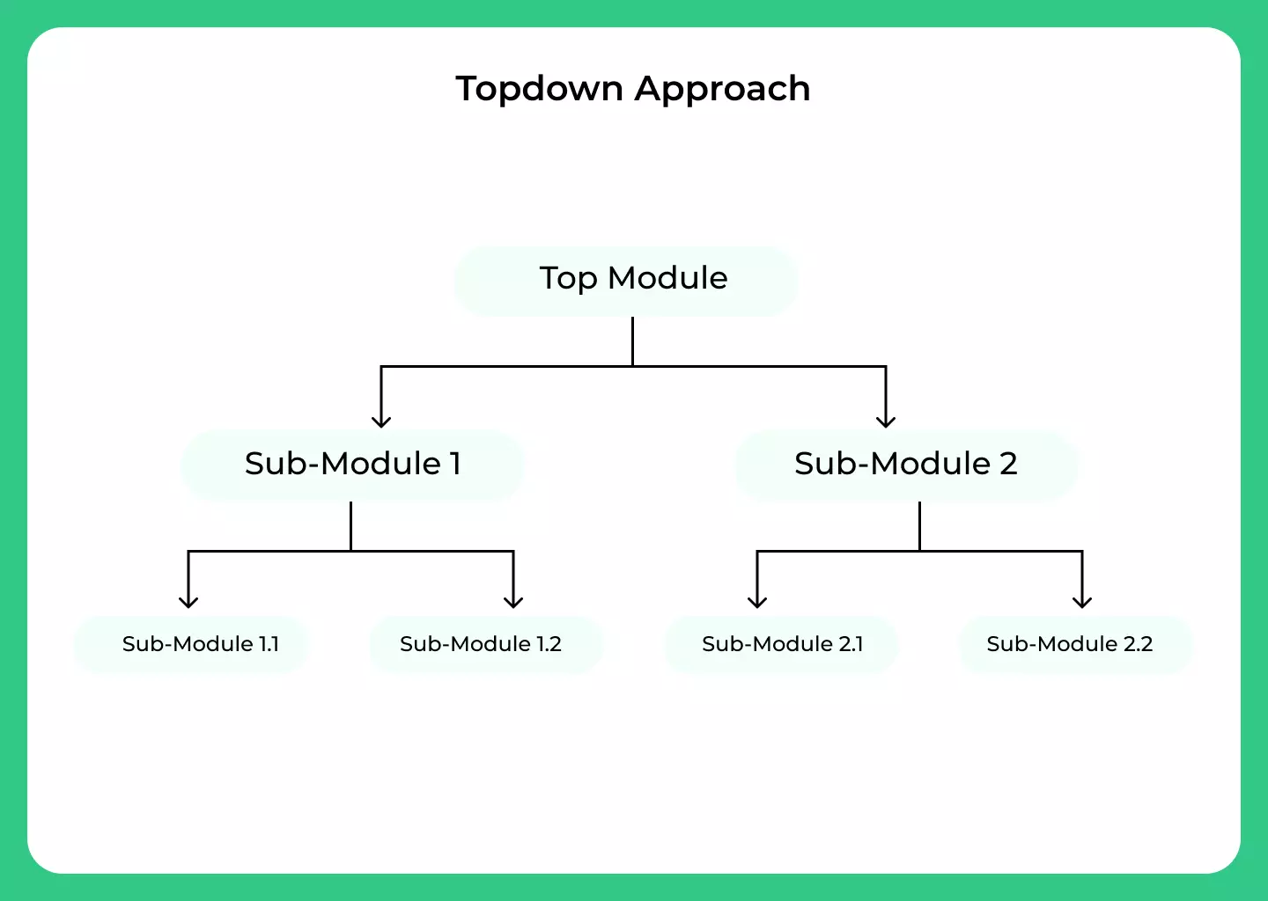

Let's see what people say about the “top-down approach”

Slide 5


Top-down approach (in work, in a problem, …)
topdown approach
Start with the big picture (from the most basic, most general thing)
Next: Divide the problem into sub-problems, the sub-problems are divided into smaller (more detailed) problems.

Slide 6
Top-down approach
Advantages
Defects
Easy to understand and implement.
Inflexibility to Changes
Creating information connections
For a new problem, it takes time to penetrate
Enhancing memory retention
Potential for Misunderstanding if the Overview is Inaccurate
Supporting decision-making and problem-solving

Slide 7
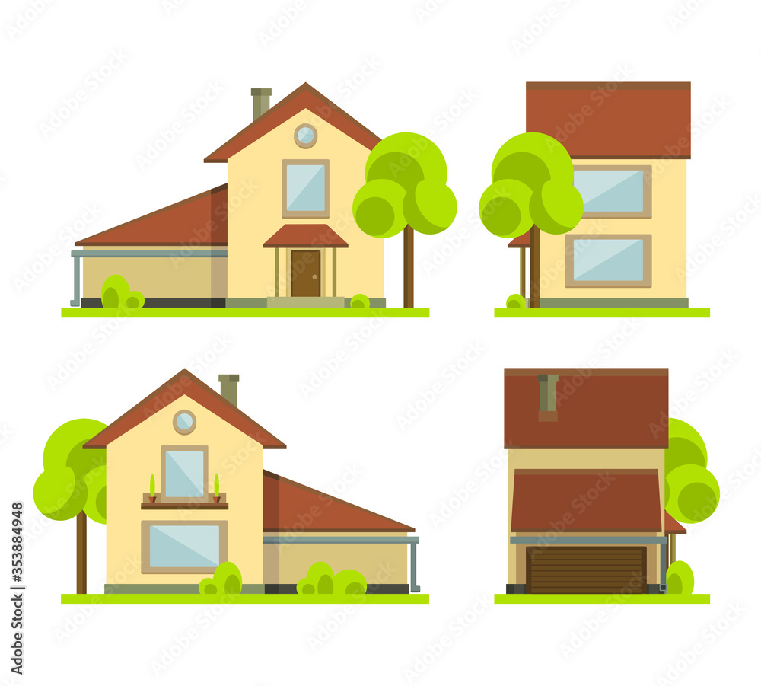

When should a top-down approach
?
overview

Slide 8
Learning how to learn and learn fast
“The content focuses on building strategies and effective learning methods”

Slide 9

What’s Learning
Learning is the process of acquiring new understanding, knowledge, behaviors, skills, values, attitudes, and preferences…

Slide 10
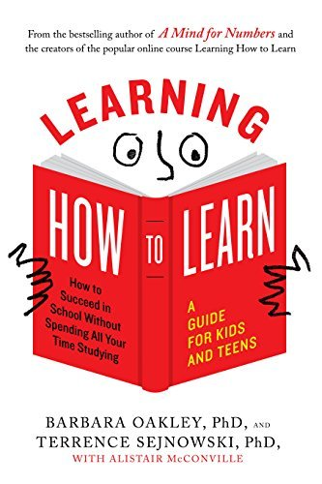
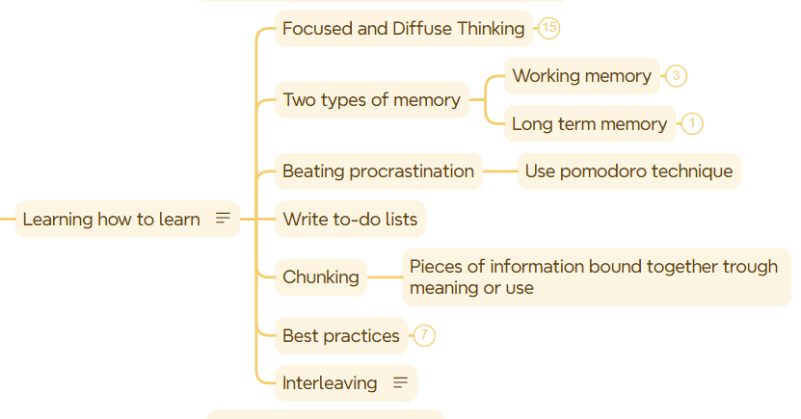
Learning how to learn

Slide 11


Apply top-down approach
?
Learn fast
Using some tools to research: Chat GPT, Bing Chat...

Slide 12

Autonomy at work

Slide 13
What's autonomy at work?
Autonomy at work means we (individual) have some level of control over how we get work done, such as how we accomplish tasks, set deadlines, and where or when they work...

Slide 14

Why is it important?
Help reach us full potential.
It allows for creativity in the workplace and promotes increased self-advocacy from us

Slide 15


Benefits
Increases motivation and productivity
Improves trust and job satisfaction
Develop skills and increase advancement opportunities

Slide 16
What’s the smart question
“is a question that is well-thought-out, clear, and designed to elicit valuable information”

Slide 17
How to ask smart questions
input
output
requirement
Think about what you already know
Confirm what you want to ask (what you don't know: can be a suggestion, answer)
Ensure simplicity and clarity

Slide 18
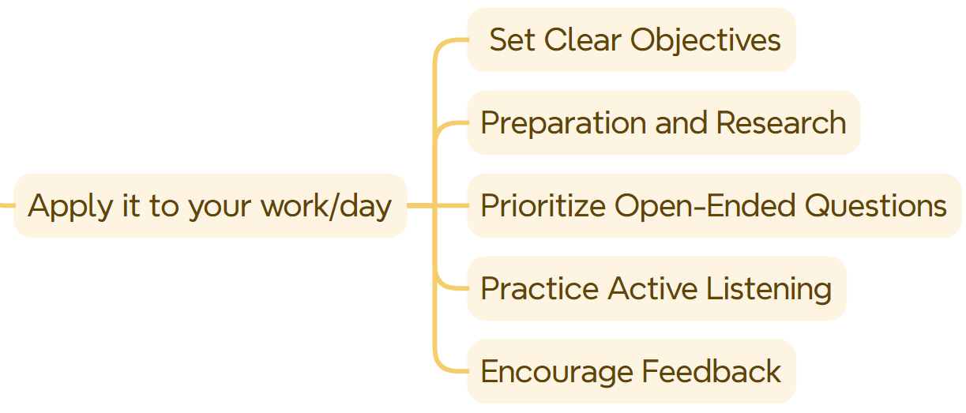
How to apply smart question on your daily basis/work

Slide 20
Thank you

